Slide 1

Lecture 9
Styling Texts
Notes:
Welcome to this M1 in SQL Course. In this first chapter of the course, we are going to do an introduction of databases and relational databases.

Slide 2

A G E N D A
Text Alignment
Text Decoration
Text Fonts / Size / Weight

Slide 3
Text Alignment
Notes:
Without further adieu, Let’s look at the course introduction so that you will know what you are going to learn.

Slide 4



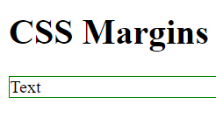
Text Alignment
We can align elements inside a container to be at the left, middle or right
<h1>CSS margins</h1>
<p>Text</p>
p {
color: 1px solid green;
}
HTML
CSS
DEFAULT ALIGNMENT IS LEFT ALIGN

Slide 5
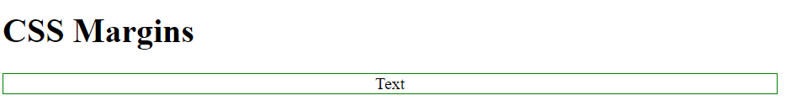
Center Align
We can align elements inside a container to be at the left, middle or right
<h1>CSS margins</h1>
<p>Text</p>
p {
color: 1px solid green;
text-align: center;
}
HTML
CSS

Slide 6
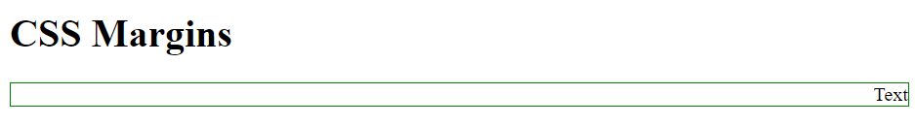
Right Align
We can align elements inside a container to be at the left, middle or right
<h1>CSS margins</h1>
<p>Text</p>
p {
color: 1px solid green;
text-align: right;
}
HTML
CSS

Slide 7
Text Decoration
Notes:
Without further adieu, Let’s look at the course introduction so that you will know what you are going to learn.

Slide 8

Underlined Text
Texts can be decorated in several ways using CSS
HTML
<h1>Text</h1>
CSS
h1 {
text-decoration: underline;
}

Slide 9

Line-Through Text
Texts can be decorated in several ways using CSS
HTML
<h1>Text</h1>
CSS
h1 {
text-decoration: line-through;
}

Slide 10
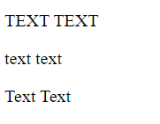
Text Transformation
Text can be transformed via uppercase, lowercase or capitalization
HTML
<p class="uppercase">Text text</p>
<p class="lowercase">Text text</p>
<p class="capitalize">Text text</p>
CSS
p.uppercase {
text-transform: uppercase;
}
p.lowercase {
text-transform: lowercase;
}
p.capitalize {
text-transform: capitalize;
}

Slide 11
Text Fonts/Size/Weight
Notes:
Without further adieu, Let’s look at the course introduction so that you will know what you are going to learn.

Slide 12

Text Fonts
The correct font choice contributes towards a satisfactory user experience
Fonts can often serve as a unique property for an organization
Adopting a font that is convenient to navigate through is integral

Slide 13
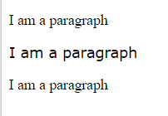
Fonts
HTML
<p class="p1">I am a paragraph</p>
<p class="p2">I am a paragraph</p>
<p class="p3">I am a paragraph</p>
CSS
.p1 {
font-family: "Times New Roman";
}
.p2 {
font-family: Verdana;
}
.p3 {
font-family: "Fira Sans";
}
Fonts consisting of multiple words have to be kept inside of quotation marks “...”
Full list of font that can be used: https://developer.mozilla.org/en-US/docs/Web/CSS/font-family
Notes:
https://developer.mozilla.org/en-US/docs/Web/CSS/font-family

Slide 14

Fallback Fonts
More than one font can be added in case the browser does not recognize it
HTML
<p>I am a paragraph</p>
CSS
p{
font-family: Helvetica, Courier, sans-serif;
}
Helvetica is the main font.
If it is not found, Courier is applied
At worst case, sans-serif

Slide 15
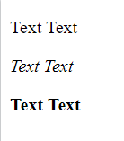
Font styling
Text can be transformed to italics or to bold
HTML
<p>Text Text</p>
<p class="italics">Text Text</p>
<p class="bold">Text Text</p>
CSS
.italics {
font-style: italic;
}
.bold {
font-weight: bold;
}

Slide 16
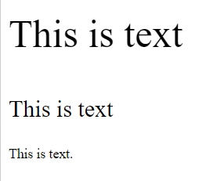
Font Size
HTML
<p class="p1">This is text</p>
<p class="p2">This is text</p>
<p>This is text</p>
CSS
.p1 {
font-size: 2.5em;
}
.p2 {
font-size: 1.5em;
}
.p2 {
font-size: 0.875em;
}

Slide 17

That’s all for this module!
THANK YOU!

Slide 18

CSS Text
CSS can be used to style text in various ways
Text Alignment
Text Decoration (not just color)
CSS Fonts
Font Weight

